Slide 1
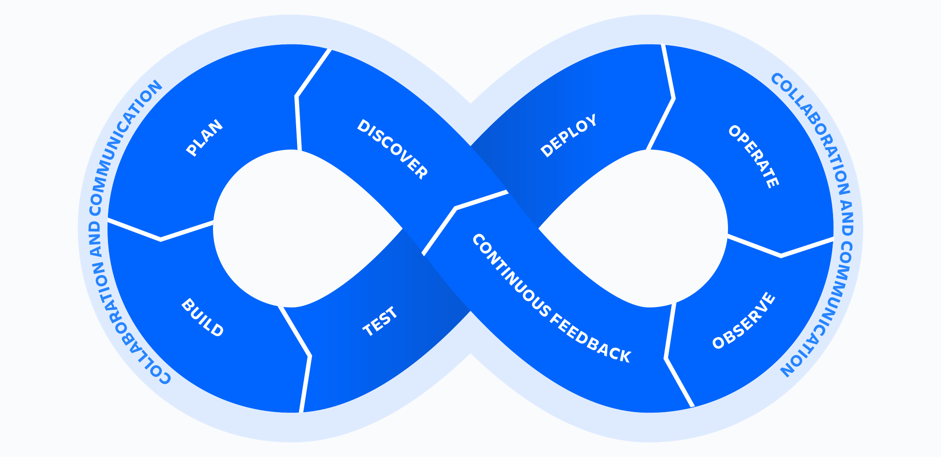
What is DevOps
DevOps is more than just development and operations teams working together. It’s more than tools and practices. DevOps is a mindset, a cultural shift, where teams adopt new ways of working.

Slide 2
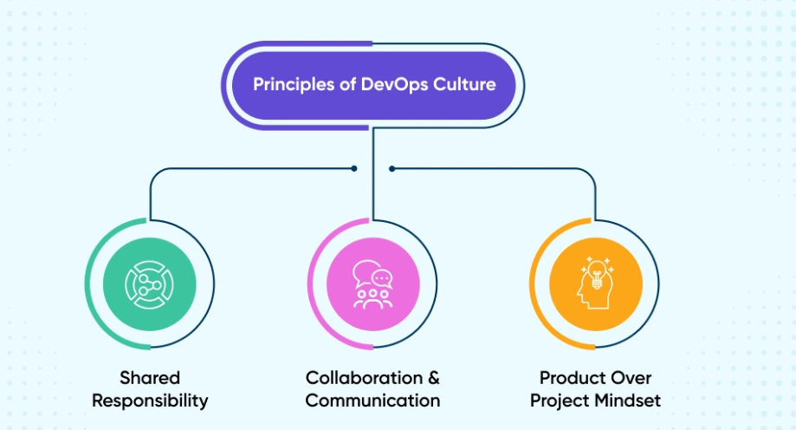
DEVOPS Culture
DevOps is more than just a set of tools or practices
https://www.atlassian.com/devops/what-is-devops/devops-culture

Slide 3
DEVOPS Culture – Key Aspects
Collaboration: DevOps encourages close collaboration between development and operations teams to break down silos and work together towards common goals.
Continuous Improvement: It promotes a culture of continuous improvement, where teams regularly reflect on their processes and seek ways to enhance efficiency and quality.
Automation: Automation of repetitive tasks is a core principle, helping to reduce errors and speed up processes.
Customer Focus: DevOps teams prioritize delivering value to customers quickly and reliably, often through continuous delivery and deployment practices.
Shared Responsibility: Both development and operations teams share responsibility for the software's performance and reliability, fostering a sense of ownership and accountability.
Learning and Experimentation: A DevOps culture encourages learning from failures and experimenting with new ideas to drive innovation.

Slide 4
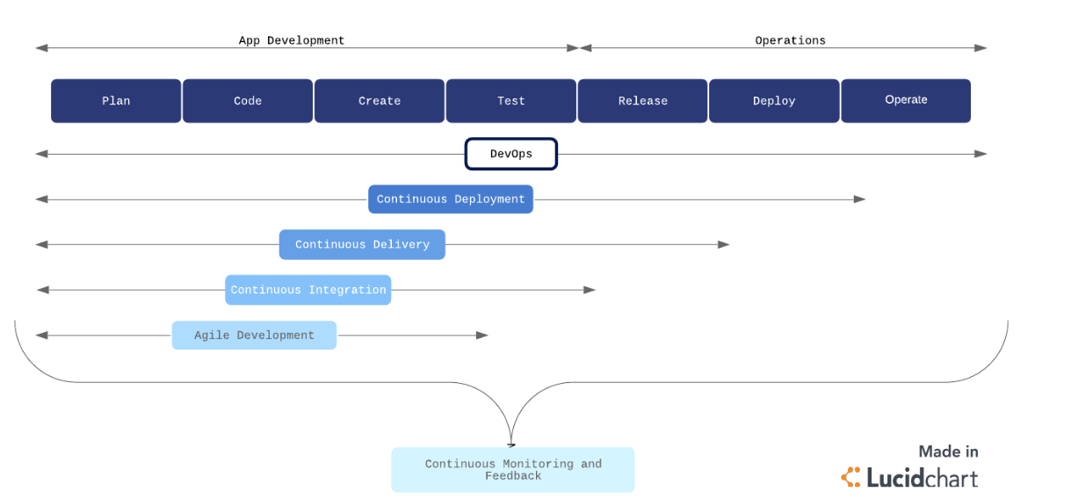
Devops Process Flow
https://www.lucidchart.com/blog/devops-process-flow

Slide 5
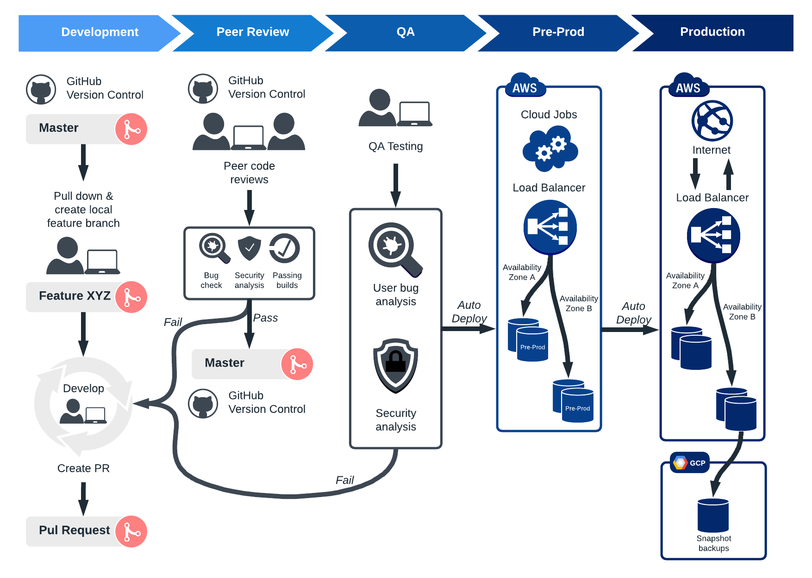
Devops Tools
https://www.lucidchart.com/blog/devops-process-flow

Slide 6
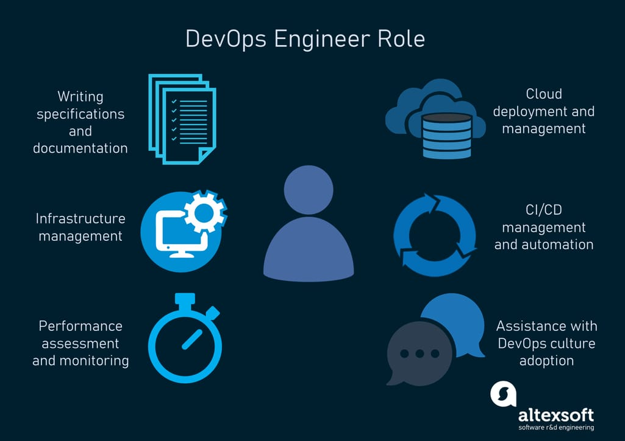
Devops Engineer Responsibilities

